Slide 1
ATPMS
Autonomous Traffic Police
Management System
IT4010 – Progress Presentation 2
Digitalizing Sri Lanka Traffic Policing End to End
M01 Dilaksha Lakshan (IT22560308)
M03 Tharindu Bandara(IT22638304)
M02 Dilan Wanniarachchi(IT22601056)
M04 Yashara Induwara(IT22642332)
WEB APPLICATION
GOV·TECH SOLUTION

Slide 2
Agenda
Problem Statement & Stakeholders
System Architecture & Integration
01
30–45 sec
05
60–90 sec
Traffic policing pain points across Sri Lanka
Tech stack, APIs, deployment, module owners
Research Gap & Objectives
Commercialization & Impact
02
30–45 sec
06
60–90 sec
What existing systems fail to address
Market, LKR cost, rollout plan 2026 - 2027
Solution Overview – ATPMS Platform
03
45–60 sec
4 module architecture & completion status
Module Deep-Dives (×4)
04
60–90 sec each
Novelties, features, tech stack, measurable impact
ATPMS – IT4010 PP2 | Confidential

Slide 3





Problem Statement & Stakeholders
Context : Sri Lanka Traffic Police nationwide field operations affecting 22M+ citizens daily
Stakeholders : Traffic Officers · Citizens · Courts · Lawyers · Ministry of Transport
Evidence Mismanagement
Manual Traffic Control
Paper based Fining
Legal Knowledge Gaps
No Citizen Safety Alerts
No secure digital vault paper evidence leads to wrongful offence attributions and case dismissals
Static signal timings create severe peak hour congestion
No adaptive logic based on real vehicle counts
Manual fine books slow, error prone
No real time visibility for citizens
Payment delays cause court backlog
Officers and citizens lack accessible law references Conflicts escalate needlessly at roadside stops
High risk zones (accidents, theft, assault) not surfaced in real time
No direct SOS channel to police
Impact: Wasted officer hours · Wrongful convictions · Preventable accidents · Declining public trust in law enforcement

Slide 4
Research Gap & Objectives
Research Gap
No existing Sri Lankan platform unifies adaptive traffic signal control, digital fine management, tamper proof evidence management, legal assistance, and real time citizen safety alerts in a single integrated government system.
Main Objective
Design and deliver ATPMS is a web based Autonomous Traffic Police Management System that fully digitalizes Sri Lanka traffic law enforcement for Officers, Citizens, Courts, and Lawyers by December 2026.
SPECIFIC OBJECTIVES
SO1
Adaptive Traffic Control
SO2
Digital Fine Ecosystem
SO3
Evidence & Legal Chain
SO4
Citizen Safety Network
Reduce peak congestion by 30%+ via AI-driven signal timing based on vehicle count, time, and environment
Eliminate paper fines with algorithm-driven officer dispatch and real-time online payment for citizens
Deploy a tamper-proof evidence vault linked to court scheduling, lawyer marketplace, and AI legal assistant
Deliver real-time high-risk zone alerts, voice-to-text complaints, and one-tap SOS to nearest police unit
ATPMS – IT4010 PP2 | Confidential

Slide 5

Solution Overview - ATPMS Platform
ATPMS is a multi role web application that end to end digitalizes Sri Lanka traffic police operations from adaptive signals to courtroom scheduling.
M1
M2
M3
M4
Smart Traffic Management
Issue Management & Reporting
Digital Fine Management
Evidence Vault & Legal Hub
Dilaksha Lakshan
Dilan Wanniarachchi
Tharindu Bandara
Yashara Induwara
▸ Paperless e-fine issuance on mobile
▸ Digital evidence vault (chain of custody)
▸ AI adaptive signal control (vehicle count + time + weather)
▸ AI ChatBot conflict mediation (Local Trained Model)
▸ Algorithm based officer task dispatch
▸ Lawyer marketplace + court scheduling
▸ Manual override for Traffic Control Centre
▸ Voice to text complaint submission system
▸ AI legal chat lawyer assistance
▸ Court-ready tamper-proof audit trail
▸ High risk zone alerts + SOS button
▸ Google Maps live congestion integration
▸ Multilingual: Sinhala, Tamil, English
▸ Police Performance Analytics dashboard
▸ Historical analytics for Police HQ
✓ Complete
✓ Complete
✓ Complete
✓ Complete
Overall Completion: 92% — Core modules complete. Final integration testing & UAT in progress.
ATPMS – IT4010 PP2 | Confidential

Slide 6
Module 1 - Smart Traffic Management | Dilaksha Lakshan
NOVELTY › First AI Adaptive Traffic Signal System in Sri Lanka
Computer Vision Detection
Impact Targets
YOLO v8 model counts vehicles per lane in real-time via CCTV feeds at intersections
30%+
<2s
Adaptive Signal Engine
Dynamic green/red duration adjusts based on vehicle density, time-of-day, and weather
Congestion Reduction Target
Signal Adaptation Latency
Manual Override Dashboard
24/7
95%+
Traffic Control Centre supervisors can override any signal city-wide from a central web panel
Live Congestion Feed
Real Time Monitoring
Vehicle Detection Accuracy
Google Maps API integration surfaces real-time traffic data for public navigation apps
TECH STACK
· Next.js · Python (YOLO v8) · MongoDB · Google Maps API · WebSockets
Analytics for Police HQ
Historical traffic pattern reports for city planners and Sri Lanka Police Command Centre
ATPMS – IT4010 PP2 | Confidential

Slide 7
Module 2 - Issue Management & Citizen Reporting | Dilan Wanniarachchi
NOVELTY › First AI Chatbot(Native Language) + Voice to Text Complaint System in Sri Lanka Traffic Policing
Impact Targets
AI ChatBot Mediation
GPT powered chatbot guides officers and citizens through conflict resolution steps in real-time
60%+
<4hr
Voice to Text Complaints
Reduction in Roadside Conflicts
Complaint Resolution Time
Citizens speak their complaint in Sinhala/Tamil/English
System transcribes, categorizes and files
3
99%
Complaint Tracking Portal
Citizens receive live status updates on complaint progress from submission to resolution
Languages Supported
Voice Transcription Accuracy
TECH STACK
Multilingual Support
· Next.js · Local Model · Web Speech API · MongoDB
Sinhala · Tamil · English input and output first trilingual police system in Sri Lanka
ATPMS – IT4010 PP2 | Confidential

Slide 8
Module 3 - Digital Fine Management System | Tharindu Bandara
NOVELTY › Fully Paperless Fine Issuance with AI Officer Dispatch Algorithm First in Sri Lanka
Mobile E Fine Issuance
Impact Targets
Officers capture offence details, attach evidence, generate signed PDF fine instantly in the field
80%+
0
Smart Dispatch Algorithm
Dijkstra/greedy algorithm routes cases to nearest available officer by location, workload, specialization
Reduction in Processing Time
Paper Documents Required
Citizen Payment Portal
18mo
100%
Citizens view, pay and appeal fines online via secure Stripe integration 24/7 access
Tamper-Proof Audit Trail
Cost Recovery Period (ROI)
Fine Records Court Ready
Every action timestamped, hash-verified and stored court ready digital records
TECH STACK
· Next.js · MongoDB · PDF.js · ReactMaps.js · Azure OCR
HQ Analytics Dashboard
Fine trends, officer performance metrics, offence hotspot heat-maps for Police Command
ATPMS – IT4010 PP2 | Confidential

Slide 9
Module 4 - Evidence Vault, Legal Hub & Citizen Safety | Yashara Induwara
NOVELTY › Integrated Evidence Vault + AI Legal Assistant + Real Time Safety Alerts › No Precedent in Sri Lanka
Digital Evidence Vault
Impact Targets
Secure upload, tagging, chain of custody tracking every file hash verified and tamper proof
50%
40%
Lawyer Marketplace
Citizens browse, filter, and contact verified traffic lawyers by expertise, rating, and location
Reduction in Wrongful Offences
Faster Emergency Response
Court Hearing Scheduler
AI
1Tap
Automated court slot booking linked to case status, judge availability, and police records
AI Legal Chat Assistant
Legal Assistance — 24/7
SOS to Nearest Police Unit
Document summarization and case guidance for lawyers and fined persons using Local Trained Model.
TECH STACK
· Next.js · Local Developed AI · Google Maps API · Local Developed Algorithm · MongoDB
High Risk Zone Alerts + SOS
Citizen map shows rape reported, theft, and accident hotspots in real time
SOS button shares GPS with nearest police
ATPMS – IT4010 PP2 | Confidential

Slide 10
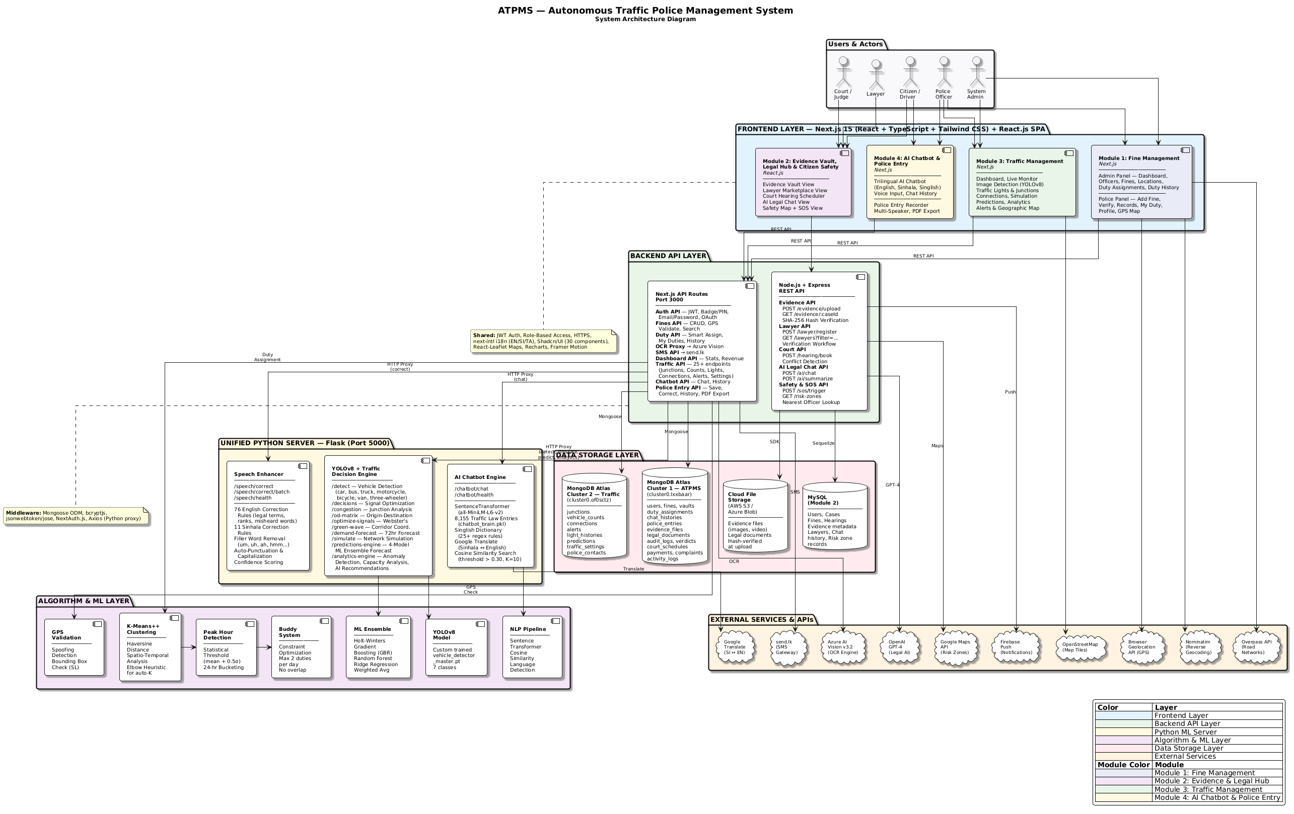
System Architecture & Integration
Deployment: Private Cloud (VMWARE / Proxmos) · Docker Containers · CI/CD Pipeline · HTTPS Enforced · 99.5% Uptime SLA
ATPMS – IT4010 PP2 | Confidential

Slide 11
System Architecture & Integration
Traffic
Officer
Citizen /
Public
Court /
Judiciary
Lawyer
Police
HQ
React.js Frontend — Role-Based SPA (Traffic Officer · Citizen · Court · Lawyer · Admin)
Node.js REST API — JWT Auth · Role-Based Access Control · Business Logic
M1
Traffic Signals
(Dilaksha)
M2
Issue Mgmt
(Dilan)
M3
Fine Mgmt
(Tharindu)
M4
Evidence & Legal
(Yashara)
MongoDB
Database
MongoDB
Real-Time
Local AI models
GPT-4 API
Google Maps
API
Lanka Pay
Payments
Deployment: Private Cloud (VMWARE / Proxmos) · Docker Containers · CI/CD Pipeline · HTTPS Enforced · 99.5% Uptime SLA
ATPMS – IT4010 PP2 | Confidential

Slide 12
Commercialization & Market Impact
TARGET MARKET
COST & REVENUE MODEL
▸ Sri Lanka Police 9,000 + traffic officers
Initial Dev + Cloud Setup: LKR 8 - 12 Million
▸ Ministry of Transport & 25 Police Districts
Annual Operations: LKR 3 Million
▸ 22M+ citizens as end-users
Revenue: Gov SaaS License + Lawyer Subscription
ROI Breakeven: 18 Months
▸ 4,000+ registered lawyers (Lawyer Marketplace)
▸ Municipal Councils & Road Development Authority
ROLLOUT TIMELINE
VALUE PROPOSITION
Q1 2026
Pilot -> Western Province (Malabe)
Only platform that replaces fragmented, paper based Sri Lanka traffic policing with a single unified digital system eliminating errors, reducing costs, and restoring public trust in law enforcement.
Q3 2026
Phase 2 -> All Provincial Capitals + Court Integration
2027
National Rollout -> All 25 Sri Lanka Police Districts
22M+
9K+
LKR3M
18mo
Citizens Served
Police Officers
Annual Ops Cost
ROI Breakeven
ATPMS – IT4010 PP2 | Confidential

Slide 13
Live Demo Plan - 30 Minutes | End-to-End Scenario
Scenario: A traffic offence occurs at a Colombo junction — follow the case end-to-end through all 4 ATPMS modules
01
Smart Signals Demo
02
Citizen Complaint Demo
03
Digital Fine Demo
04
Evidence & Safety Demo
Dilaksha
Dilan
Tharindu
Yashara
1. Show adaptive signal reacting to simulated vehicle surge
1. Citizen submits voice complaint about officer conduct
1. Officer issues e-fine on mobile PDF generated instantly
1. Upload evidence to vault , view chain of custody log
2. Toggle manual override from Control Centre dashboard
2. AI ChatBot guides real-time conflict resolution
2. Dispatch algorithm assigns nearest available officer
2. Book lawyer via marketplace
AI summarizes legal doc
3. Display live congestion change on Google Maps feed
3. Track complaint status from submission to resolution
3. Citizen pays fine online via Stripe portal
3. Trigger SOS button
GPS shared with nearest police unit
Backup: Pre recorded screen capture video + pre loaded test data on demo account + screenshots per module
Watch For: Signal timing change on live map · Voice transcript accuracy · Fine PDF generation · AI legal summary quality
ATPMS – IT4010 PP2 | Confidential

